Slide 1

Temporal Feature-Driven Machine Learning Framework for ODI Score Prediction and Player Role Classification
Guided by
Dr. Vidivelli S
Presented by
Priya Dharshini V – 127018063 (CSBS)
1
School of Computing

Slide 2
Presentation Layout
Motivation
Objective
Problem Statement
Literature Survey
Flow Diagram / System Architecture
Dataset & Preprocessing
Proposed Methodology
Results
Future Work
References

Slide 3
Motivation
ODI ball-by-ball data contains rich sequential information about scoring, wickets and player context.
Final-score prediction depends on both the current innings state and recent match momentum.
Static features alone may miss short-term changes in scoring rate, boundaries and wickets.
Player role classification provides a complementary player-level analytics task.
A reproducible ML pipeline is required from raw Cricsheet data to deployable predictions.

Slide 4
Objective
Predict the final ODI innings score from the current match state.
Introduce temporal features that capture recent scoring, ball quality and wicket momentum.
Compare multiple machine-learning regressors and build the final XGBoost score model.
Classify players into Batsman, Batting All-rounder, Bowler and Bowling All-rounder.
Evaluate performance using test metrics, cross-validation and detailed error analysis.

Slide 5
Problem Statement
Given ball-by-ball ODI information at a particular point in an innings, estimate the final innings score.
Handle numerical match-state features and categorical context such as teams, venue and players.
Engineer temporal information without using future deliveries or causing data leakage.
Prediction error varies across innings stages, score ranges and overs remaining.
A second ML task classifies players using batting and bowling performance statistics.

Slide 6
Literature Survey
Study | Dataset / Approach | Key Contribution
Suguna et al. (2023) - Base Paper | Cricsheet ODI + ML models | Score prediction + 4-class player categorization
Lawate et al. | IPL ball-by-ball data | Used recent 5-over statistics for score prediction
Gagana et al. | T20 match data | Compared Naive Bayes, Decision Tree and Random Forest

Slide 7
Literature Survey
Research Gap | Proposed Focus
Limited temporal context | Combine current innings state with multi-window recent features.
Hidden stage-wise errors | Analyse error by innings stage, score range and overs remaining.
Early/short innings | Explicitly test robustness instead of removing difficult cases.

Slide 8
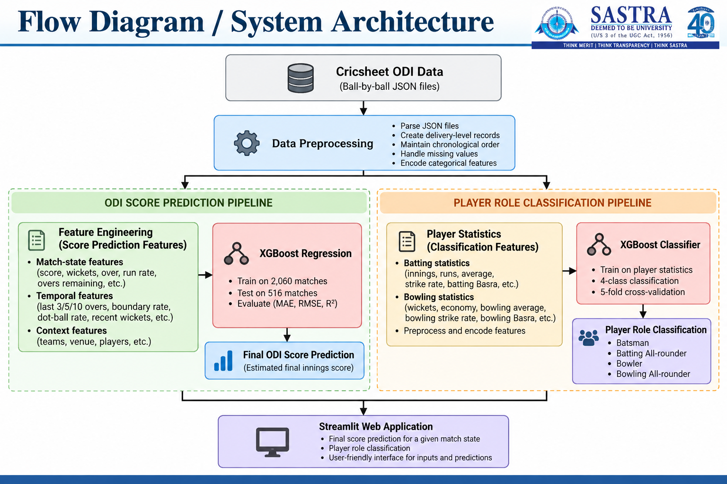
System Architecture

Slide 9
Dataset Description
• Dataset: Cricsheet Men's ODI ball-by-ball JSON data.
• 2,576 ODI matches were used in the chronological match-level evaluation.
• The processed dataset contains 1,366,311 delivery records.
• Each delivery contains innings context, teams, players, runs and wicket information.
• The final score-prediction pipeline uses 20 model input features.
• Player classification dataset contains 1,340 player records across four role classes.

Slide 10
Dataset Preprocessing – Data Preparation
• Parse each Cricsheet JSON match into structured delivery-level records.
• Preserve chronological delivery order within every innings.
• Create match, innings, over and ball identifiers for feature construction.
• Track cumulative score, wickets and current run rate at each prediction point.
• Use a randomized match-level split so test matches do not overlap with training matches.

Slide 11
Dataset Preprocessing – Targets & Role Labels
• Score-prediction target: final score of the corresponding ODI innings.
• Player-classification target: four role classes derived from batting and bowling statistics.
• Role 0 → Batsman
• Role 1 → Batting All-rounder
• Role 2 → Bowler
• Role 3 → Bowling All-rounder
• The player dataset contains 1,340 labelled records.

Slide 12
Feature Engineering – Model Inputs
13 numerical features include
  innings
  over
  ball
  total score
  wickets
  last 5 overs score
  current run rate
  overs remaining
  last 3 overs score (short term momentum)
  last 5 overs score (medium term momentum)
  last 10 overs score (longer recent context)
  boundary rate
  dot ball rate
7 categorical features:
  season, venue, batting team, bowling team, batter, non-striker and bowler.
Temporal variables include last-3/5/10-over scoring, boundary rate, dot-ball rate and recent 5-over wickets.
Categorical variables are one-hot encoded with unknown categories handled safely.
Final score-prediction input size = 20 features.

Slide 13
Methodology – Match-State Features
• Current score and wickets describe the present innings state.
• Over and ball identify the exact point within the innings.
• Current run rate summarizes scoring pace up to the prediction point.
• Overs remaining provides the remaining opportunity to add runs.
• These state features form the baseline representation before temporal information is added.

Slide 14
Methodology – Temporal Features
• Last-3, last-5 and last-10-over scores capture recent scoring momentum at multiple time scales.
• Boundary rate measures the frequency of fours and sixes in recent context.
• Dot-ball rate represents pressure and low-scoring deliveries.
• Recent 5-over wickets capture wicket momentum and changing batting stability.
• Ablation testing evaluates which temporal groups contribute to final performance.

Slide 15
Methodology – XGBoost Models
• Final score predictor: XGBoost regression pipeline.
• Preprocessing combines numerical passthrough with one-hot encoding for categorical variables.
• The model was selected after baseline comparison and temporal-feature experiments.
• Player classifier: XGBoost multiclass classification using batting and bowling statistics.
• Saved model artifacts are integrated into the Streamlit demonstration application.

Slide 16
Training & Testing Workflow
• Randomized match-level split: 2,060 training matches and 516 testing matches.
• Training and testing matches have zero overlap.
• Training records: 1,093,612 delivery rows; testing records: 272,699 delivery rows.
• Train on earlier matches and evaluate on later unseen matches.
• Player classification additionally uses stratified 5-fold cross-validation.

Slide 17
Result – Score Prediction Metrics
• Final XGBoost: MAE 32.95 runs, RMSE 44.25 runs, R² 0.5229.
• Exact match-level analysis: MAE 32.93 runs, RMSE 44.27 runs, R² 0.5252.
• Adding all temporal features improves the state-only MAE from 33.23 to 32.95.
Model | MAE / RMSE / R²
XGBoost | 32.95 / 44.25 / 0.5229
SVM | 33.47 / 45.24 / 0.5065
Random Forest | 33.44 / 45.40 / 0.4998
Gradient Boosting | 34.68 / 46.04 / 0.4855
Linear Regression | 38.46 / 50.18 / 0.3891

Slide 18
Result – Player Classification
• XGBoost test accuracy = 99.25%; weighted F1 = 99.25%.
• 5-fold stratified CV accuracy = 97.61% ± 0.90%.
• Random Forest: 97.76% test accuracy; 96.72% mean CV accuracy.
• SVM: 91.04% test accuracy; 89.25% mean CV accuracy.
• The engineered batting/bowling profiles provide strong separation among the four role classes.

Slide 19
Result – Error Analysis
• Overall match-level evaluation: MAE 32.93 runs, RMSE 44.27 runs, R² 0.5252.
• By innings stage: Powerplay MAE 47.88; Middle overs 31.90; Death overs 12.58.
• By current score: MAE falls from 46.11 for scores below 50 to 15.38 for scores above 200.
• By overs remaining: MAE is 47.91 when more than 40 overs remain and 12.75 at 0–10 overs remaining.
• Accuracy improves as the innings progresses and more information about the final score becomes available.

Slide 20
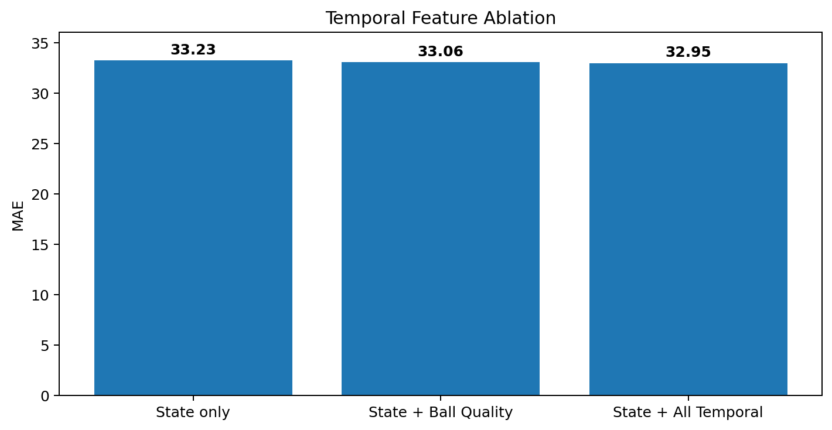
Result – Ablation & Robustness
• State-only MAE = 33.23; State + Ball Quality = 33.06; State + All Temporal = 32.95.
• Long innings (30+ overs): MAE 29.88; Very short innings (<10 overs): MAE 187.52.
• Short/early-terminated innings remain the major robustness limitation.
• Difficult cases were retained rather than removed from evaluation.

Slide 21
Future Work
Improve early-innings and short-innings prediction using richer sequential representations.
Investigate calibrated prediction intervals or uncertainty estimates for predicted scores.
Evaluate additional temporal models such as sequence-based neural architectures.
Extend validation to other cricket formats and competitions where compatible data is available.
Continue refining the Streamlit interface for live/demo-style prediction workflows.

Slide 22
References
Cricsheet, Men's ODI ball-by-ball JSON data, used for delivery-level match modelling.
Suguna R., Praveen Kumar Y., Suriya Prakash J., Neethu P.S., and Kiran S., “Utilizing Machine Learning for Sport Data Analytics in Cricket: Score Prediction and Player Categorization,” 2023 IEEE 3rd Mysore Sub Section International Conference (MysuruCon), 2023.
S. Gagana, "A Perspective on Analyzing IPL Match Results using Machine Learning," Int. J. for Sci. Research & Development, vol. 7, no. 3, pp. 1476-1479, 2019.
A. Lawate et al., "Cricket Analysis and Prediction of projected Score and Winner using Machine Learning," Int. J. of Adv. Research in Computer and Comm. Engg., vol. 10, no. 2, 2021.
Chen, T. and Guestrin, C., “XGBoost: A Scalable Tree Boosting System,” KDD, 2016.
Pedregosa, F. et al., “Scikit-learn: Machine Learning in Python,” JMLR, 2011.
Python Software Foundation, Python documentation and scientific-computing ecosystem.

Slide 23
Project Resources & Implementation
• Dataset source: Cricsheet Men's ODI JSON data.
• Processing: delivery-level parsing and chronological match-level train/test separation.
• Feature engineering: state features + recent scoring + ball quality + wicket momentum.
• Score model: final_xgboost_model.pkl.
• Player model: final_player_classifier.pkl.
• Demo application: app.py using Streamlit.
• Repository: github.com/VPriyaDharshini2/cricket-score-prediction-ml

Slide 24
THANK YOU

